Slide 1


KRAM & ASSOCIATES MARKETING SOLUTIONS
NATIONWIDE INSURANCE COMPANY
175 South Third Street, Ste. 200,
Columbus, OH 43215
(614) 402-5672
www.krammarketingsolutions.com
The end
Nationwide Headquarters
One Nationwide Plaza
Columbus, Ohio 43215-2220
www.nationwide.com

Slide 2


WELCOME
OUR NAME
DID YOU KNOW the word KRAM in Sweden means "HUG" ?
Hugs are a great way to express affection. Hugging shows that you care about a person and that you support him/her.
Hug to embrace…
To accept (an opportunity, challenge, etc.) willingly or eagerly
To take up (a new idea)
To comprise or include as an integral part
To encircle or enclose
In essence, while we at Kram and Associates Marketing Solutions, don't spend all day 'kramming,' or 'hugging' each other (well... unless someone needs that), we do embrace diversity, readily accept each other's differences, willingly share our strengths, take up and formulate new ideas, and challenge ourselves to produce high-quality work that will bring us referrals and repeat business!
At Kram and Associates Marketing Solutions, we actively listen to our clients, and include their ideas, philosophy, brand and corporate message as an integral part of the work we produce for them. We embrace the opportunity to work with a variety of businesses, and we challenge ourselves to meet and exceed client expectations, every time!
KRAM & Associates Marketing Solutions

Slide 3

WHO ARE WE
KRAM and Associates Marketing Solutions, Inc. (KRAM), founded in 1985, provides top tier marketing solutions that meet and exceed client expectations and increase their market share.
KRAM's rich consortium of business partners, including NATIVA, provides clients with cost effective, one- stop-shop solutions for Marketing, Market Research, Printing, Graphic Design, Branding, Web Design and Development, Social Media Interactions
and internet technology.

Slide 4






KRAM & ASSOCIATES SERVICES
PROJECT
MANAGEMENT
CREATIVE
SERVICES
WEB
SERVICES
INFORMATION TECHNOLOGY
KRAM provides consulting, research, strategic marketing, brand management, and quality assurance to ensure a consistent message across all communication platforms.
Our creative services provides consistent branding for our clients that includes Advertising and Graphic Design, Printing, Direct Mail campaigns
and Media buying.
Our team is able to assist in the design and development of your website and online promotions, integrate market research, social media, e-commerce and interactive media solutions.
KRAM is your partner in the design and installation of aerial
or underground fiber optic cabling, computers, computer peripheral equipment and associated services.

Slide 5






SOME OF OUR REKNOWN CLIENTS
KRAM & Associates enjoys an impressive list of clients, including, but not limited to Honda, Columbus State Community College, Kroger, the Ohio Educational Technology Conference and the Columbus Chamber of Commerce.
HONDA OF AMERICA MANUFACTURING, INC.
Designed and created multiple, general ads to attract American, Hispanic, Somalian, and Asian employees and suppliers. These ads were used on multiple communication platforms (in magazines, brochures, signage, website, trade publications) for a period of 4 years.
COLUMBUS STATE COMMUNITY COLLEGE
Designed and printed numerous brochures and bookmarks as part of their outreach to potential minority students to consider Columbus State as a smart choice for academic learning and degree pursuit.
KRAM
MAJOR CLIENTS
THE KROGER COMPANY
Create their quarterly employee magazine, signage, promotional items, business cards, stationery, and holiday cards for Kroger as part of their overall branding strategy.
COLUMBUS CHAMBER OF COMMERCE
Designed and developed a 20 page Program Book, Stationery, Press Ads, Invitations, various Signage and Web Banners for the Columbus Chamber’s Small Business Leader Awards, that attracted approximately 1400 individuals.
On your next project
WE LOOK FORWARD TO HELPING YOU
OETC - OHIO EDUCATIONAL
TECHNOLOGY CONFERENCE
Event Branding for OETC was created, attracting over 4,000 attendees and 5,500 total participants. This included over 40 different onsite, dimensional Room Signs; a mobile app package consisting of various graphic elements for the iPad, iPhone and Android; a 120 page Conference Program Guidebook; an Exhibitor Prospectus and Save The Date advertisements.

Slide 6





KRAM & ASSOCIATES Marketing Solutions
+ NATIVA Multicultural Communications Agency
Mark Hall, CEO, Founder, KRAM & Associates
Natasha Pongonis, Co-Owner, NATIVA

Slide 7

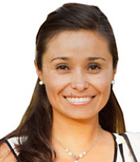
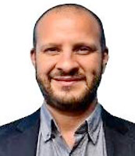
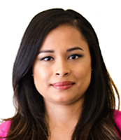
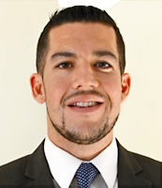
OUR TEAM
TALENTED. EDUCATED. Multicultural. Big Heart. Big Ideas!
A diverse and multicultural team that represents and understands the global marketplace.
MARK HALL
President and CEO
KRAM & Associates
Marketing Solutions
NATALIE PONGONIS
Co Owner
NATIVA Multicultural
Communications Agency
RAFAEL AMEZCUA
Marketing Manager
NATIVA Multicultural
Communications Agency
SYLVIA VASQUEZ
Marketing Account Manager
NATIVA Multicultural
Communications Agency
ERIC DIAZ
Co Owner
NATIVA Multicultural
Communications Agency

Slide 8




Nativa is a multicultural communications agency that focuses on the Hispanic market through digital communications, online advertising and culturally relevant content creation. Nativa also provides traditional marketing services
through strategic partnerships with specialized agencies.
SERVICES
SOCIAL MEDIA MARKETING
HISPANIC MARKET RESEARCH
Nativa provides a service that enables our clients to fully engage with their target market (Hispanic or general market) through daily social media communication.
Nativa provides clients with custom Hispanic research to serve as input into their marketing campaigns.
ONLINE LISTENING INSIGHTS
SOPHISTICATED WEB DESIGN & TRANSCREATION
Our clients receive custom reports that detail how consumers discuss their brand/organization online including from social media sites such as Facebook and Twitter.
All Nativa websites include well focused original copy, design focused on user experience as well as internal content management controls (CMS). Nativa also provides culturally relevant trans-creation for existing English sites.
ONLINE ADVERTISING
TRADITIONAL MARKETING
Nativa's digital advertising management includes: Strategy, execution, optimization, and ROI reporting.
Nativa's 360 degree approach can help you combine traditional marketing (radio, TV, print) with digital and community events.
BLOGGER MANAGEMENT
EMAIL MARKETING
Our clients are able to broadcast their message, event, or brand name effectively to the community through a network of general market or Latino bloggers that communicate daily with this specific audience
Reinforce your social media and internet marketing strategies with constant reminders sent directly to your subscribers' inbox.

Slide 9
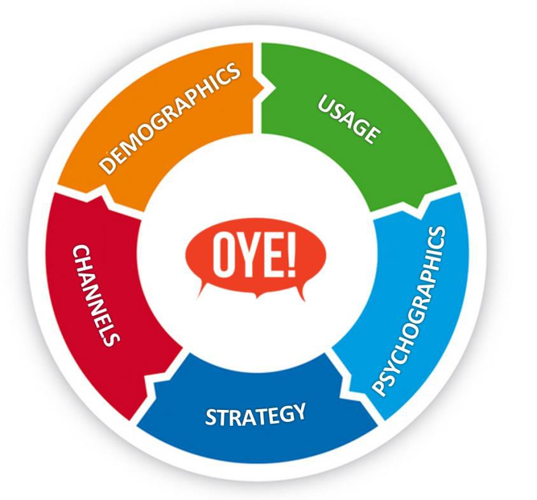
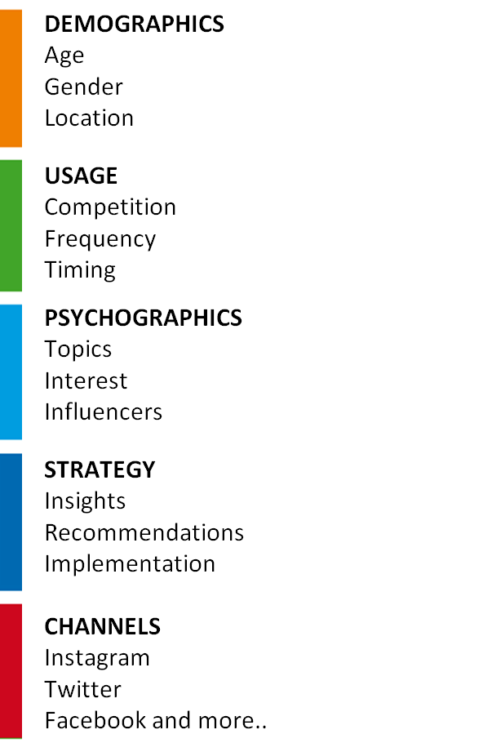
WHY WORK WITH US
OYE! Business Intelligence
Nativa’s proprietary technology: captures the authentic voice of online consumers.
DATA ANALYTICS
THE SOLUTION
OYE! proprietary algorithm analyzes Hispanic conversation to allow brands to understand different aspects of where their target audience segments are.
ACTIONABLE INSIGHTS
analyze conversation in English, Spanglish and Spanish to derive meaning from unstructured social conversation.
THE VALUE $$
Better conversion, lift and engagement resulting from campaigns tailored to the Hispanics most influential over purchasing decisions .

Slide 10

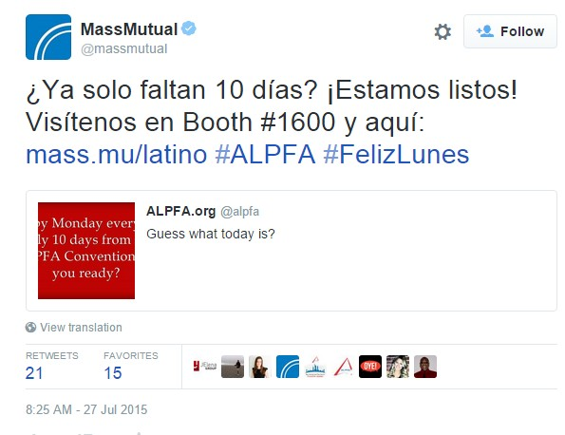
MASS MUTUAL FINANCIAL
Objective:
Closely monitor relevant online conversations surrounding MassMutual brand and competitors among Hispanics.
Analyze data by geography, sentiment, volume, language use, gender and conversational topic trends.
Build best strategy to reach Hispanic demographic.
OYE!
Using OYE! insights on monthly basis – Observed upward trend in Hispanic online mentions with total conversation increasing month over month.
Positive sentiment has increased consistently - up to 60% in 2015.
Brand has achieved under 1% negative sentiment every month since measurement began in January 2014.
Results:
Identified the strategic choices behind top competitors.
Combined competitive knowledge with additional analysis of most successful social campaigns.
Identified local agents as key conversation drivers in targeted regions.
Drew conclusive evidence that traditional media outreach increases conversation
MASS MUTUAL
MassMutual above mentioning their activation with partner, ALPFA and their 2015 convention with Spanish postings.
MAY
5%
JUNE
8%
JULY
65%
JULY
11%
JUNE
28%
MassMutual’s progress in increasing Hispanic conversation.
(last 3 months)
MAY
7%
MassMutual’s progress in increasing Hispanic conversation.
(last 3 months)

Slide 11
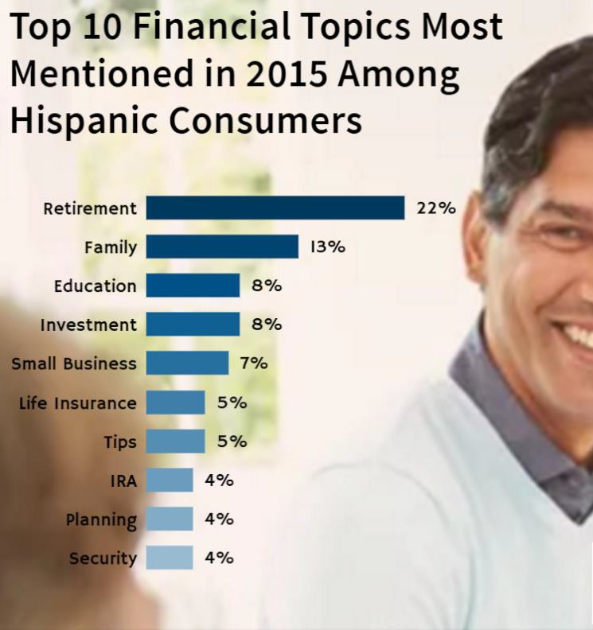




2015 FINANCIAL INDUSTRY
OYE! analytics helps organizations better understand the Hispanic consumer.
Financial service industry brands that ranked in top 5 - dedicated campaigns specifically targeting Hispanics.
Hispanics use Spanish more frequently when generating personal content opposed to responding to content published by brands in English
Conversation spiked throughout the year around Hispanic’s holidays/ campaigns designed to deliver Hispanic engagement.
35-44 age group most engaged in the financial services industry.

Slide 12

KRAM & Associates
Marketing Solutions
+
NATIVA
Multicultural Communications Agency
STRATEGIC PARTNERSHIPS

Slide 13










KRAM Clients
FEATURED CLIENTS
Nativa Clients
Partnership
Clients

Slide 14
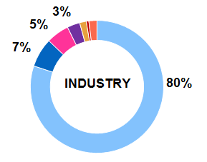
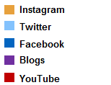
KROGER PHARMACY
Objective:
Determine the share of voice among online users for Kroger Pharmacy through social forums such as Twitter, Instagram, Facebook, and blog posts.
Identify conversation drivers and topics in the industry as well as for Kroger Pharmacy. Include in-depth analysis for cold & cough conversations.
Competitive insights analyzing two top competitors nationwide.
Results:
Identified the social channel with most organic conversations
Male users had the highest percentage of share of voice
with 60% of total conversations.
Corporate policies shared on social media or news outlets can generate positive response.
Partnership that provide additional benefits to customers increases customer satisfaction.
TWITTER IS THE SOCIAL CHANNEL WITH THE MOST CONTENT FOR
ALL BRANDS

Slide 15





Columbus City Schools discovered there was a challenge between issues raised by students and parents that
were not being addressed in the Hispanic, Somalian,
Nepalese and other communities. KRAM & Associates and Nativa will identify the best social media platforms for use by both students and the parents to encourage and strengthen engagement in these cultures.
COLUMBUS CITY SCHOOLS
This scope of work will include identifying ways to help decrease this communication gap which will include translation services, community organizations and resources that can provide
in-reach to these communities.

Slide 16
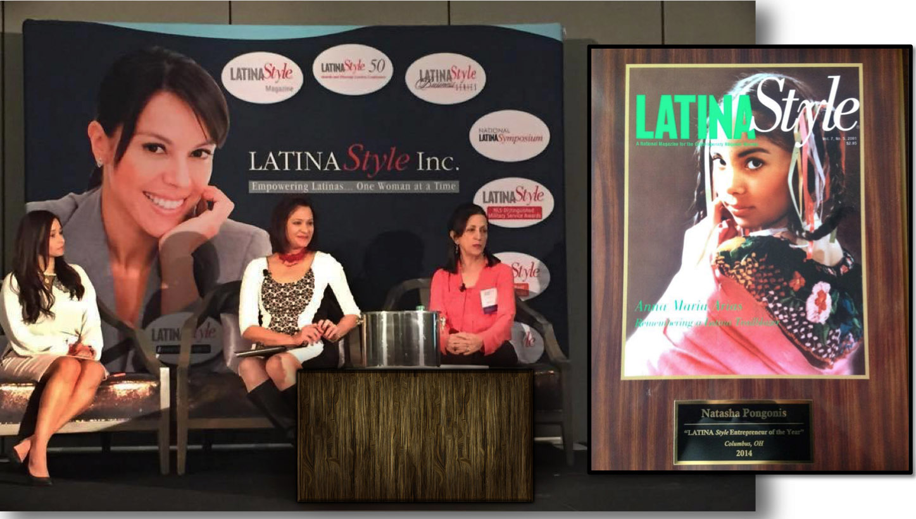
COMMUNITY LEADERSHIP
Natasha Pongonis, 2014 Latina Entrepreneur of the Year

Slide 17
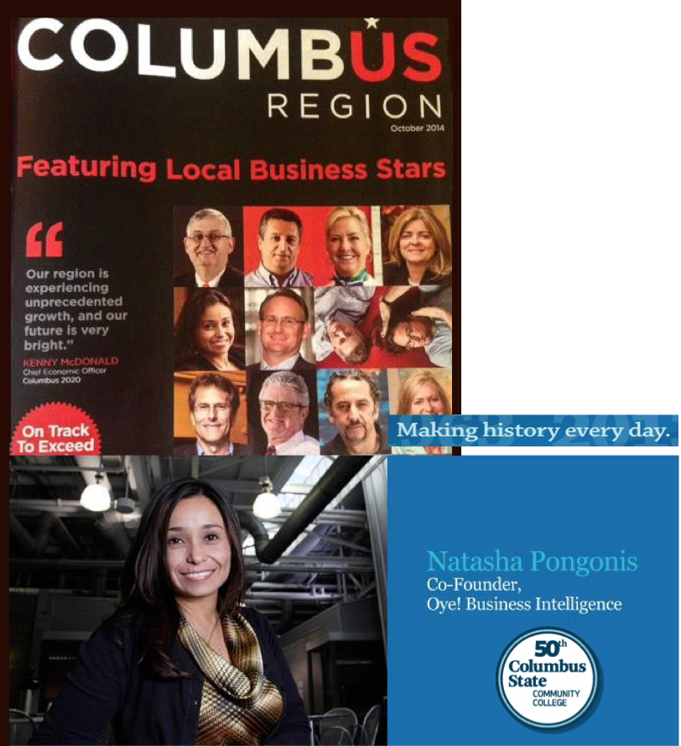
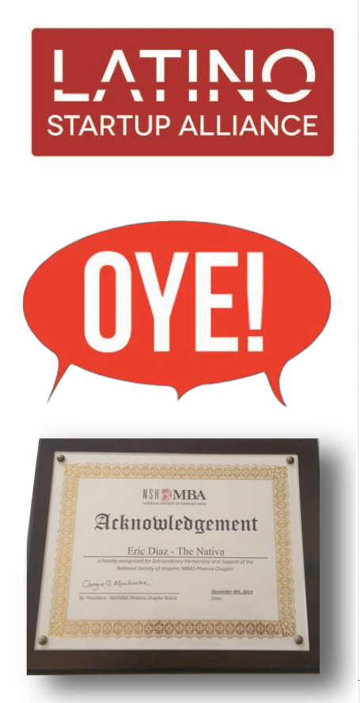

COMMUNITY LEADERSHIP
NATIVA: A Minority and Woman Led Company

Slide 18

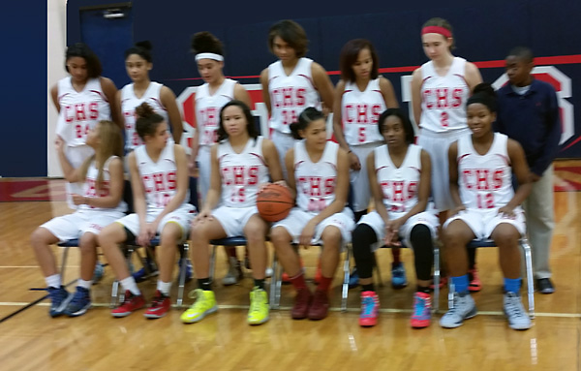
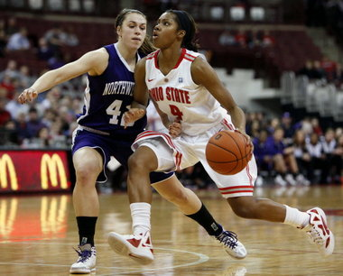
COMMUNITY LEADERSHIP
Commitment to Clients and the Community
High school Girls’ Assistant Basketball Coach for 15 years
Simba Mentor Volunteer for African-American youth
between the ages of 5-18
Served on the Columbus Chamber’s Small Business Council
for 6 years
Recipient in the Over $1 Million category for the
Columbus Chamber’s Small Business Leader Award
Fast 50 for Business First – top 25 companies
for over 5 years
Corinthian Baptist Church, Committee for
Church Improvements

Slide 19
MOTION GRAPHICS
KRAM & Associates offers state-of-the-art motion graphics services. These run the gamut from simple digital media: web banner ads, slideshows, e-cards, web intros and splash pages, to the more complex feature-length films, short films, television productions and commercials.
Partnered with Webphotographix and Rich Marchewka,
we can deliver small, media files for the web or large, ultra-high definition files with
increased bandwidth connections to locations all over the world. KRAM has 4K capability and beyond.
WEB GRAPHICS
TELEVISION ADS
WEB BANNER ADS & SLIDESHOWS
SAFE UTIMATE CAR SECURITY SYSTEM
Various Web Banner Ads and Slideshow developed for Columbus State Community College
Television Ad: 1.30 min.
DIRECT TV BUNDLES & WHITTIER TRUST
E-CARD
Christmas E-Card created for Columbus State Community College
Interview style Television Ads for Direct TV and Whittier Trust: 1.30 min. each.
WEB INTRO/SPLASH PAGES
YOUR AT&T DEVICES
3 Web Intros / Splash pages produced for the Digital Media Department at Columbus State Community College
4K AT&T Devices Television Ad: 1.30 min.

Slide 20

CONTACT US
KRAM & Associates Marketing Solutions + Nativa Multicultural Communications Agency
COLUMBUS
COLUMBUS
(614) 402-5672
krammkt@msn.com
175 S. Third St., Ste. 200
Columbus, OH 43215
www.krammarketingsolutions.com
(614) 719-9245
natasha@krammarketingsolutions.com
1275 Kinnear Road
Columbus, OH 43212
www.thenativa.com
PHOENIX
(602) 277-0224
eric@krammarketingsolutions.com
3428 N. 15th Avenue
Phoenix, AZ 85015
www.thenativa.com
A diverse and multicultural team that understands and represents the global marketplace.

Slide 21


THANK YOU

