Slide 1
KRAM & ASSOCIATES
marketing SOLUTIONS

Slide 2
ABOUTUS
Kram and Associates Marketing Solutions, Inc. (KRAM) provides top tier marketing solutions that meet and exceed client expectations and increase their market share. Kram's rich network of business partners, provides clients with a cost effective, one- stop-shop, solutions for Marketing, Printing, Graphic Design, Website Development, E-commerce, Social Media and Internet Technology.
At Kram and Associates Marketing Solutions, Inc. we believe in diversity. We are a minority-owned business that hires the best freelance designers and technical staff, many of whom are experts in their fields and have their own businesses. Our mobile staff work from their preferred locations, and are available to meet as needed. Consequently, we enjoy lower overhead costs... A savings we gladly pass on to you!
For big businesses, Kram and Associates Marketing Solutions, Inc. can provide creative, freelance services and access to skills unavailable in-house and on an as needed basis. We can help you cut costs by supplementing a core full-time workforce with skilled, temporary, project workers.

Slide 3




OURTEAM
MARK HALL
GISELLE WHITE
NICOLE PONGONIS
SUE HARRAH
CEO & FOUNDER
Creative Director
Social Media Director
Internet Technology Director
Mark Hall, former VP and Partner of Three Leaf Productions, Inc. was instrumental in taking the company from $100K to $10 million in 10 years. In this position he was responsible for growing major accounts nationally and locally, along with developing a nationwide supplier base. Mark was in charge of maintaining a partnership with new and existing businesses.
Giselle provides graphic design, corporate branding, print and promotional advertising, website development and interactive media solutions Giselle works directly with clients to help them achieve their communications objectives. Giselle’s 15+ years experience in Print & Web Design, Sales, Marketing & Management, enable her to effectively meet client needs and surpass their expectations!
Natasha Pongonis, provides research and marketing analyses that enables clients to fully engage with their Spanish, and other demographic clientele. Being fluent in four languages: English, Spanish, French & Italian- enables her to reach out and connect with a diverse digital audience across the globe.
Sue has developed relationships with a wide range of manufacturers so we're able to bring you the best technical Sales and Support Hardware & Software IT Infrastructure, Smart WiFi, Networking and Storage, Security, Maintenance and Repair service and solutions.

Slide 4

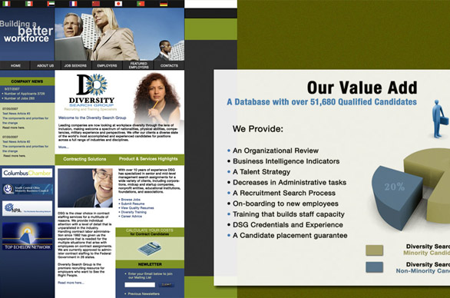

2. CREATIVE SERVICES
1. PROJECT MANAGEMENT SERVICES
Print, Graphic Design, Advertising, Corporate and Event Branding Services
Advertising & Marketing – Newspaper, Print & Production Media Buying
Direct Mail Campaigns; Door-to-Door Distribution Services
Media Buying – Television and Radio Broadcast
Consulting
Research
Strategic Marketing
Brand Management
Quality Assurance
WEPROVIDE

Slide 5
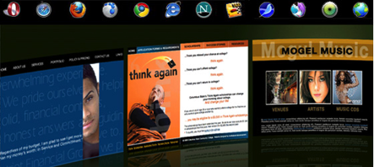

3. WEB DEVELOPMENT SERVICES
Web Design and Development Services
Social Media Integration & Demographic Research
Ecommerce and Content-Management Systems (CMS)
Interactive Media Solutions
4. PRINTING
Customized Printing to meet clients’ needs: Mailing Inserts, Stationery, Posters, Programs, Brochures, Annual Reports, Promotional Items, Die-Cut Sheets, etc.
Finishing & Binding; Mailing and Shipping
Maintenance Services

Slide 6

5. INFORMATION TECHNOLOGY
Information Technology - Integration of voice, Video and Data
Sub Cabling - Maintenance and Installation
Fiber, Copper, Underground, Aerial, Card Readers
Computer, Computer Peripheral Equipment, Monitor, Laptop and Software Merchant Suppliers
NAICS Codes:
541613 – Marketing Consulting Services
561439 – Other Business Service Centers (Blueprinting and Copying)
238210 – Electrical Contractors and Other Wiring Installation Contractors (Computer and network cable installation)
423420 – Computer and Computer Peripheral Equipment and Software Merchant Wholesalers
237130 – Power and Communication Line and Related Structures Construction

Slide 7








ourshowcase
HONDA : HISPANIC BRANDING
XTEK : WEB DEVELOPMENT
COLUMBUS CHAMBER : BRANDING
LOGO DESIGN & COLLATERAL
INDIANA ENERGY : BRANDING
KROGER : CHRISTMAS CARDS
COLUMBUS STATE : PRINTING
APDS COLLATERAL & BRANDING

Slide 8

HONDAproject
PRINT PROMOTIONAL BRANDING
krammarketingsolutions.com/HONDA-PRESS-Magazine-ADS.html
PROJECT: Marketing Materials for Honda of America was created.
WHAT WAS DONE: 1. The Word Cloud design concept was created to show Honda as being innovative, diverse, modern and trendy.
2. Marketing Material comprising Press, Publication, Magazine Ads, Posters and bi-lingual Brochures were created.
3. Collateral Printing

Slide 9


APDSproject
CORPORATE BRANDING
krammarketingsolutions.com/APDS-CorporateBranding.html
PROJECT: Corporate Branding for APDS (Africentric Personal Development Shop)
WHAT WAS DONE: 1. A Powerpoint Presentation was created, to reflect the new APDS brand.
2. A Corporate Branding package comprising: Business Cards, Stationery (Letterhead and Envelopes), Brochure, Appointment Cards, Posters and Flyers and Pocket Folder were put together.
3. APDS Website is currently being developed.

Slide 10
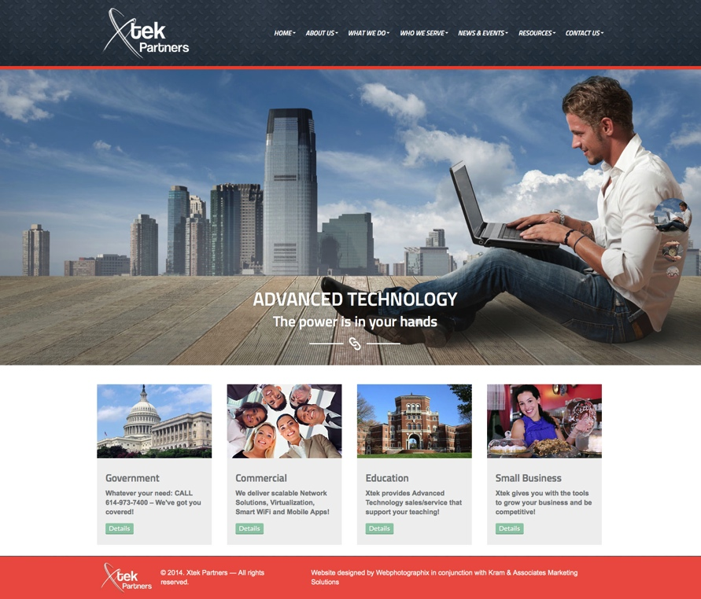
XTEK PARTNERSproject
WEBSITE DEVELOPMENT
http://www.xtekpartners.com
PROJECT: Redesign and develop client’s website.
WHAT WAS DONE: 1. Research and competitive analysis was done so as to best position client and promote a healthy ROI.
2. Website was designed to attract Xtek’s target market and encourage and reassure potential customers that the company was not only credible but able to take on big projects.

Slide 11


COLUMBUS CHAMBER project
SPECIAL EVENT BRANDING
krammarketingsolutions.com/BRANDING-CHAMBER.html
PROJECT: Event Branding for Columbus Chamber of Commerce 2012 Business Summit.
WHAT WAS DONE: 1. An event logo design was created, to reflect the ultra-conservative, corporate brand of the Columbus Chamber of Commerce.
2. An Event Branding package comprising: Press Ads, Invitations and Envelopes, was put together.
3. Marketing Materials including a promotional Invitation, Web Banners and a 20-page Program were created.

Slide 12



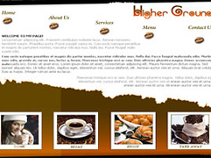



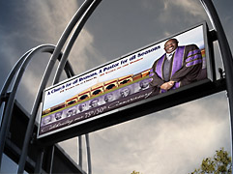
ourshowcase
LOGO DESIGN
CORPORATE BRANDING
MARKETING MATERIALS
WEB DEVELOPMENT
PROMOTIONAL ADVERTISING
SALES & MEDIA KITS
BROCHURES & CATALOGS
BILLBOARDS & SIGNAGE

Slide 13
THEKRAMDIFFERENCE
Our QUALITY and FLEXIBILITY is what sets us apart from our competitors.
We hire the best freelance designers and technical staff, many of whom are experts in their fields and have their own businesses.
Our staff works from their preferred locations, and are available to meet as needed. Consequently, we enjoy lower overhead costs… A savings we gladly pass on to you!
For big businesses, Kram and Associates Marketing Solutions provides creative, freelance services and access to skills unavailable in-house and on an as needed basis.
We can help you cut costs by supplementing a core full-time workforce with skilled, temporary, project workers.

Slide 14
CLIENTStESTIMONIALS
# | List Major & Minor Customers | Referrals
1 | KROGER COMPANY | JO FORD (Kroger Company)
2 | HONDA | PAULA CARTER (Honda)
3 | OHIO FACILITIES CONSTRUCTION COMMISSION | PAULA GLEDHILL (Palmer Donavin)
4 | PALMER DONAVIN MANUFACTURING | MARSHIE SKINNER (Ohio Facilities Construction Commision)
5 | AFRICENTRIC PERSONAL DEVELOPMENT SHOP (APDS)
6 | NATIONWIDE INSURANCE

Slide 15

CONTACTUs
WEBSITE
For more information on who we are and what we do, visit our website at www.KramMarketingSolutions.com
PHONE
If you are serious about taking your business to the next level, we would love to hear from you! Call us at 614-402-5672, where one of our representatives will be glad to assist you.
E-mail
To find out how we may make your next project a success or request a FREE QUOTE tailored to your needs, send us a message at info@KramMarketingSolutions.com

Slide 16
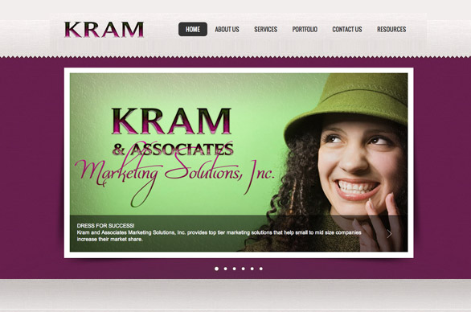
THANK YOU
FOR YOUR
TIME!

