Slide 1

APDS: Africentric Personal Development Shop
Notes:
Upload image into the light grey box, and then move and place the transparency box on top the grey box(with image)

Slide 2

APDS is an innovative behavioral healthcare center, established in 1988. It provides programs for the prevention, treatment, and recovery from alcohol and other drug use disorders; provides domestic violence intervention and prevention education classes; and personal development programs for youth and young adults.
APDS is primarily funded by the ADAMH Board of Franklin County
2
Notes:
Right click on the mock-up, click group and click ungroup.
To change image click on the grey box twice, right click and change image

Slide 3

OUR VISION
To be a nationally recognized innovative behavioural healthcare leader specializing in substance abuse treatment and domestic violence intervention education for a diverse client base (As measured by client success, partner support, and accrediting bodies).
3
Notes:
Right click on the mock-up, click group and click ungroup.
To change image click on the grey box twice, right click and change image

Slide 4
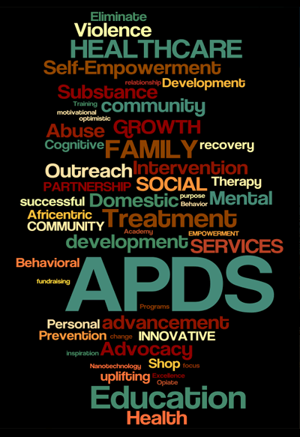

OUR MISSION
To provide innovative and appropriate treatment, social services, education and prevention programs to prevent, treat, and eliminate substance abuse and domestic violence.
Notes:
Right click on the mock-up, click group and click ungroup.
To change image click on the grey box twice, right click and change image

Slide 5

OUR PURPOSE
To provide culturally responsive behavioural healthcare and personal development programs.
To promote the belief that healthy families are the foundation of successful communities.
To encourage lifestyles that lead to optimal health to reduce conflict and provide empowerment.
To offer Africentric consultation, educational programs, cultural activities, and community-wide events to strengthen the community in general and youth in particular.
Notes:
Right click on the mock-up, click group and click ungroup.
To change image click on the grey box twice, right click and change image

Slide 6
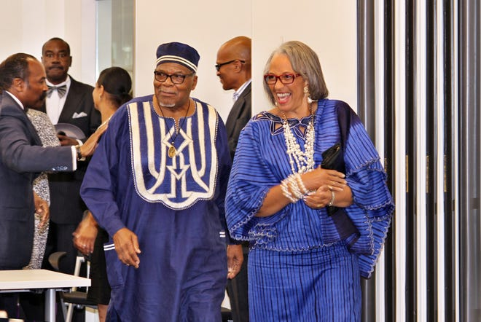
OUR FOUNDERS

Slide 7

APDS certified by OMHAS
Certified by Ohio Mental Health and Addiction Services
American Society of Addiction Medicine (ASAM)
APDS curriculums based on Motivational Interviewing & Cognitive Behavioural Therapy
APDS at the forefront of serving African American community
Serving over 23,000 families since 1988
7
Notes:
Right click on the mock-up, click group and click ungroup.
To change image click on the grey box twice, right click and change image

Slide 8


Client Demographics in Counseling Programs
95% of Clients are Black. Clients experience one or more MEB risk factors:
Mental health/substance use comorbidity
Unemployment/Underemployed
250% Federal Poverty Level
Generational familial/cyclical abuse
* Majority referrals: FCMC, FCCS, client word of mouth
Notes:
Right click on the mock-up, click group and click ungroup.
To change image click on the grey box twice, right click and change image

Slide 9
Annual Projections CY2023
Projected 374 AOD (Substance Use Disorders) clients
(187 successful completions)
Projected 160 AFAR(Domestic Violence) consumers
(104 successful completions)
APDS serves 117 to 167 adult clients weekly in our treatment and prevention programs.
9
Notes:
Right click on the mock-up, click group and click ungroup.
To change image click on the grey box twice, right click and change image

Slide 10

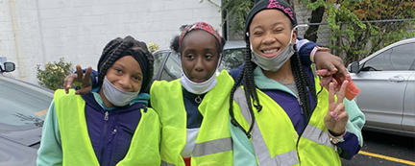

Projected 120 SMART 2.0 students (6-12 yrs.)
(96 successful completions)
Projected 50 UCANN youth and young adults (11 to 22 yrs.) (38 successful completions)
Projected 120 Urban GEMS youth (12 to19 yrs.)
(90 successful completions)
Notes:
Right click on the mock-up, click group and click ungroup.
To change image click on the grey box twice, right click and change image

Slide 11
City of Columbus Empowerment Grants
City of Columbus Empowerment Grants
APDS is one of four Key Partners providing support to community-based programs in Central Ohio.
APDS provides 11 grants ranging from $10K to $25K to 11 organizations providing youth and family empowerment programs
11
Notes:
Right click on the mock-up, click group and click ungroup.
To change image click on the grey box twice, right click and change image

Slide 12
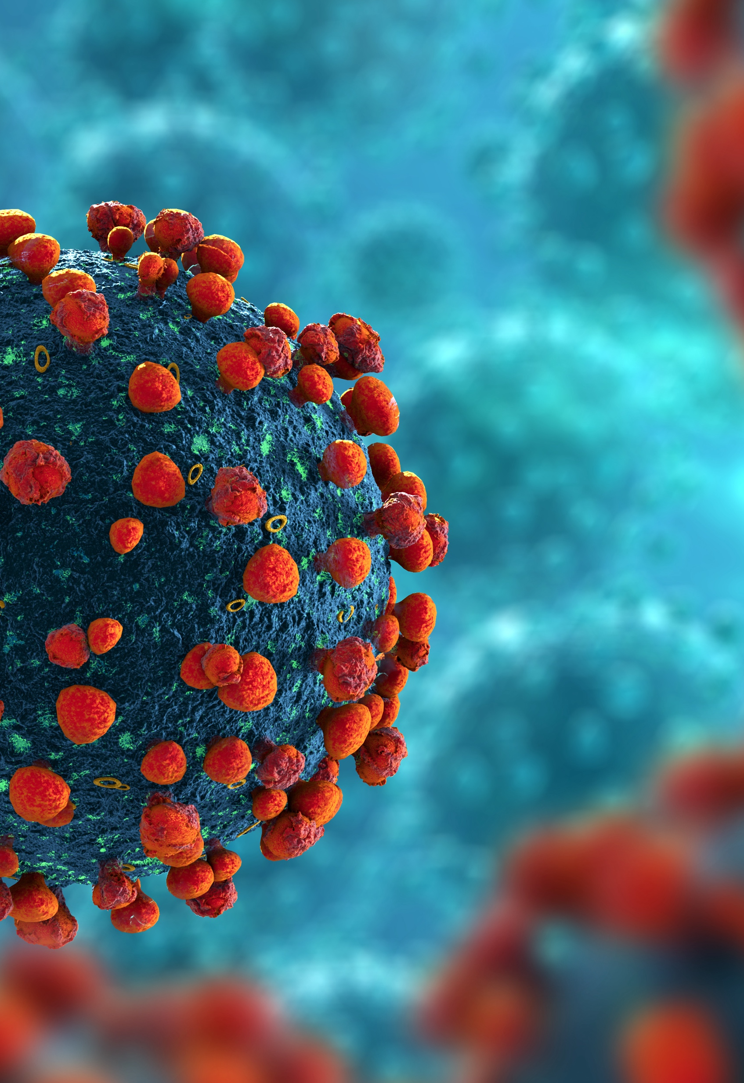
COVID-19 IMPACT
54% increase in Alcohol sales
234% increase in Online sales
* ALCOHOL IS A DRUG. Alcohol addiction is a serious health problem.
Notes:
Right click on the mock-up, click group and click ungroup.
To change image click on the grey box twice, right click and change image

Slide 13
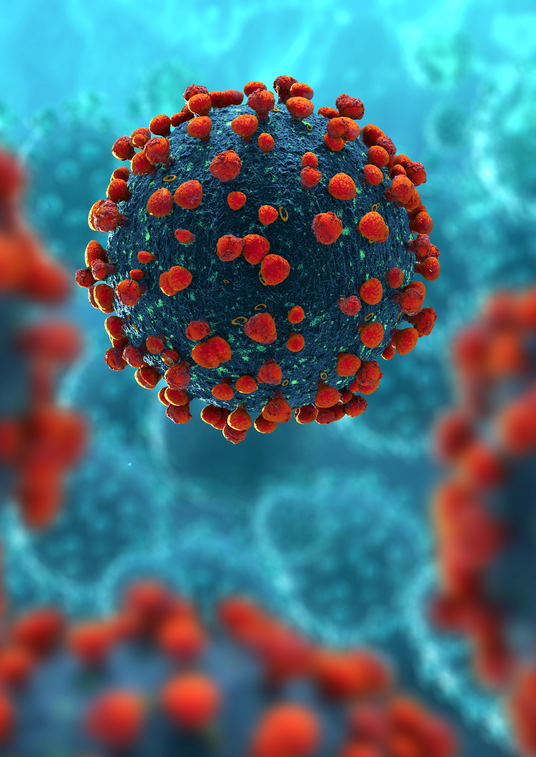

Alcohol-Involved Deaths (Acute) in Franklin County
January - September 2019 to 2020 45.6% increase
Alcohol Addiction is a serious health problem.
Notes:
Right click on the mock-up, click group and click ungroup.
To change image click on the grey box twice, right click and change image

Slide 14
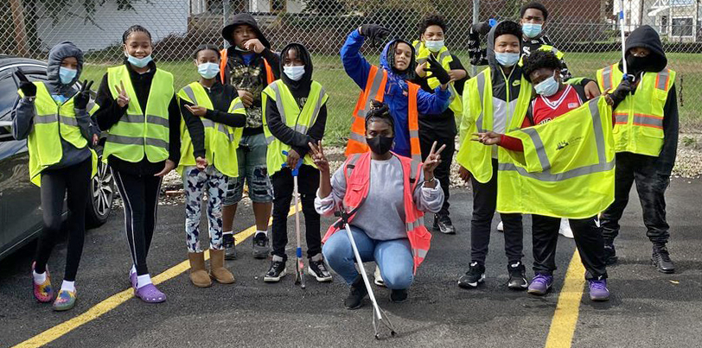

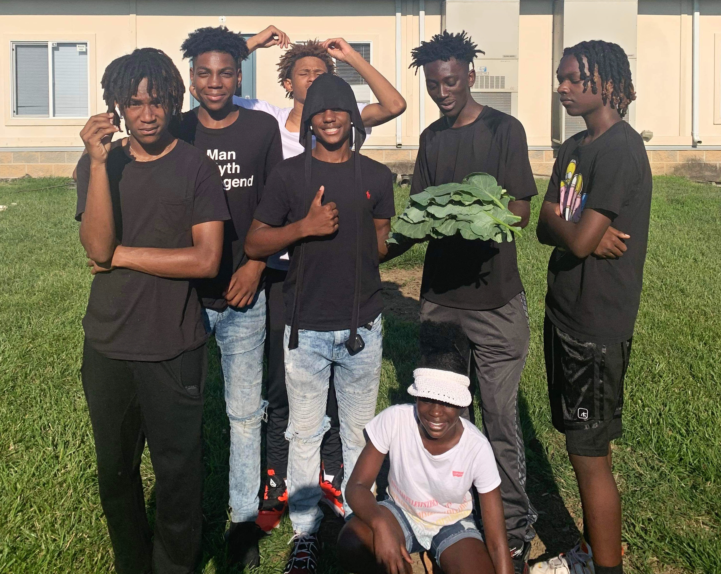
Additional APDS Outreach Programs for Youth in Central Ohio
UCANN – Unified Community and Neighborhood Networks
9-week Summer Day Camp for 120 youth ages 6 to 12 years old
APDS SMART 2.0
9-week Summer Day Camp
120 youth ages 6 to 12 years old
URBAN GEMS (Gardening Entrepreneurs Motivating Sustainability)
120 youth ages12-19 years old

Slide 15
“The child who is not embraced by the village will burn it down to feel its warmth..”
– African Proverb

Slide 16


Slide 17
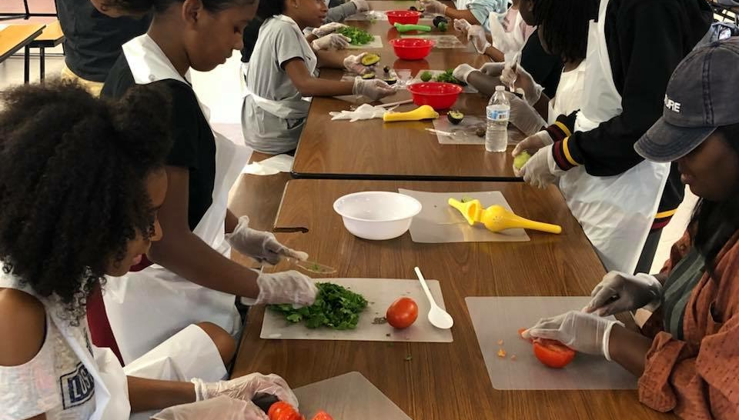

Slide 18
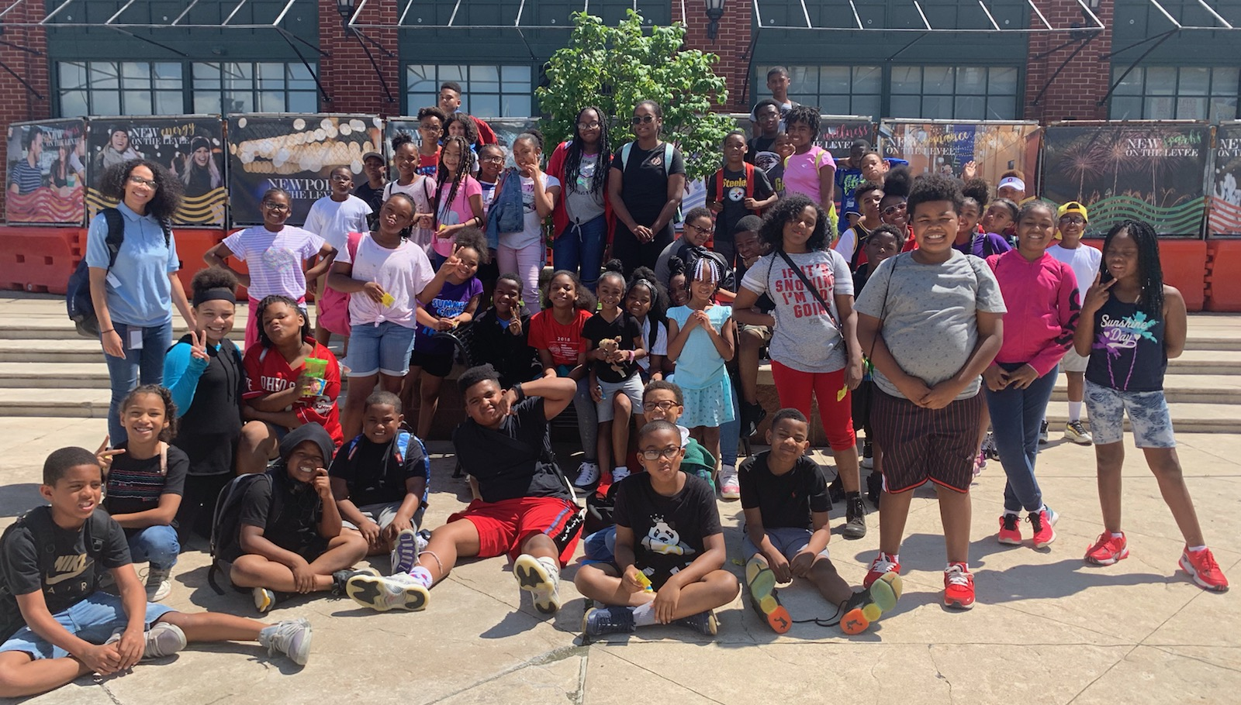

Slide 19
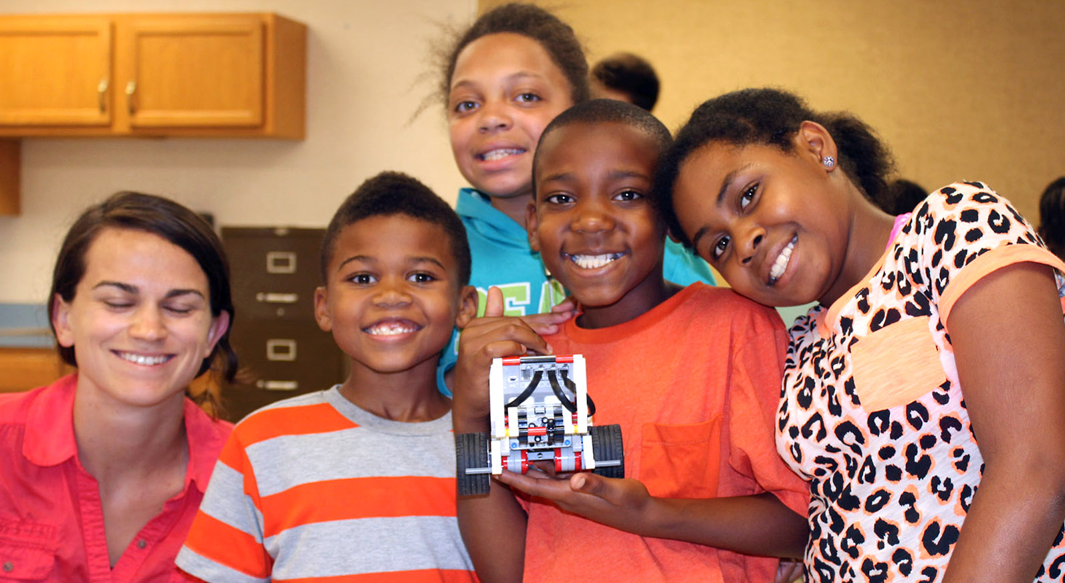

Slide 20
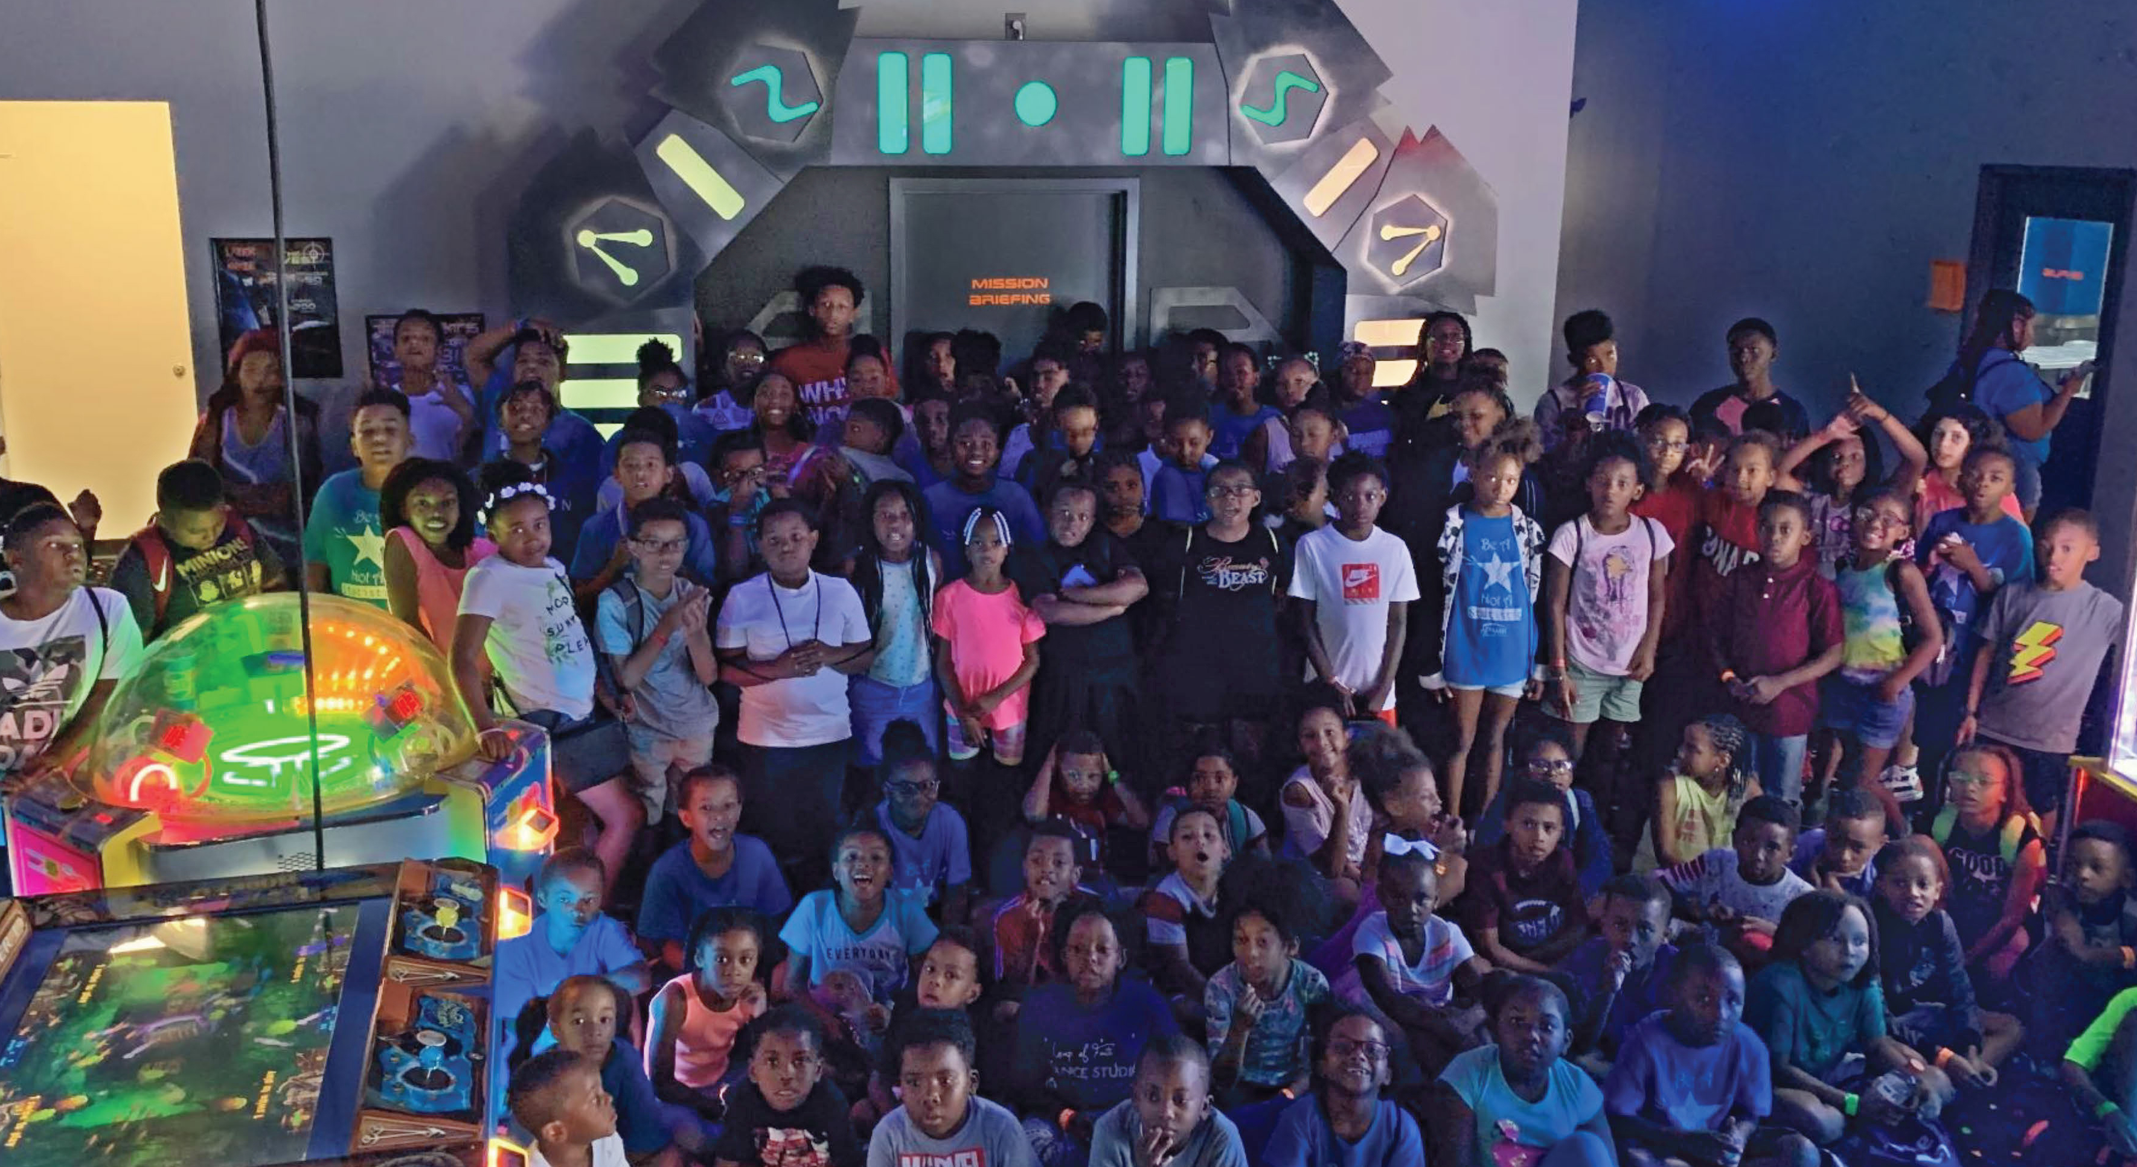

Slide 21
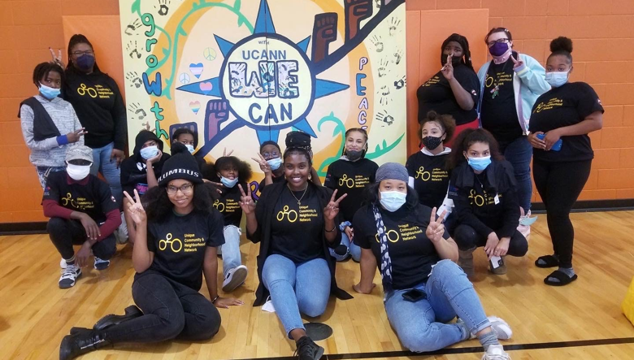

Slide 22
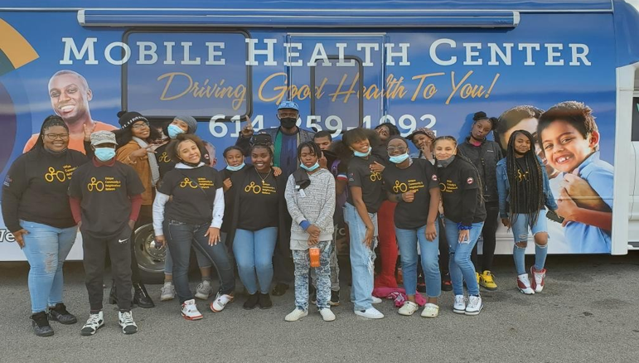

Slide 23
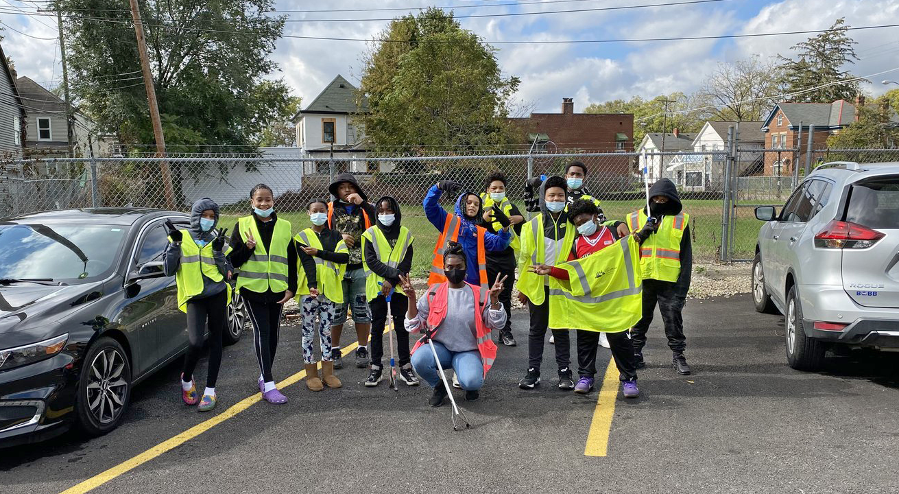

Slide 24
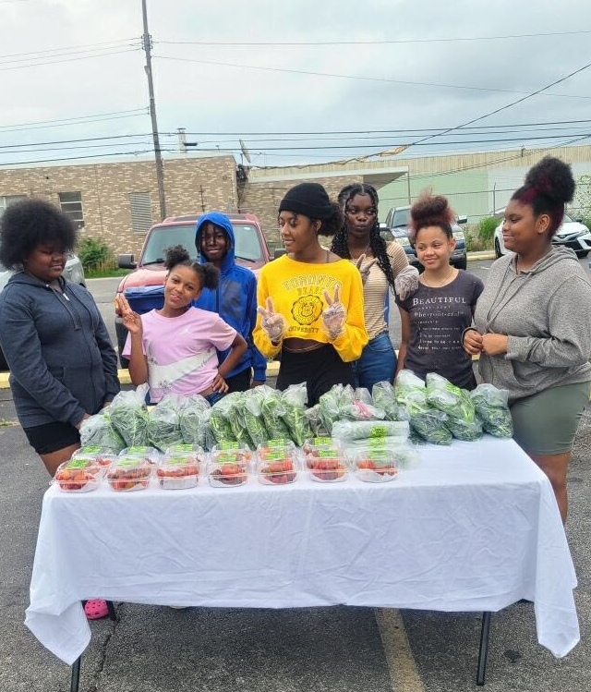
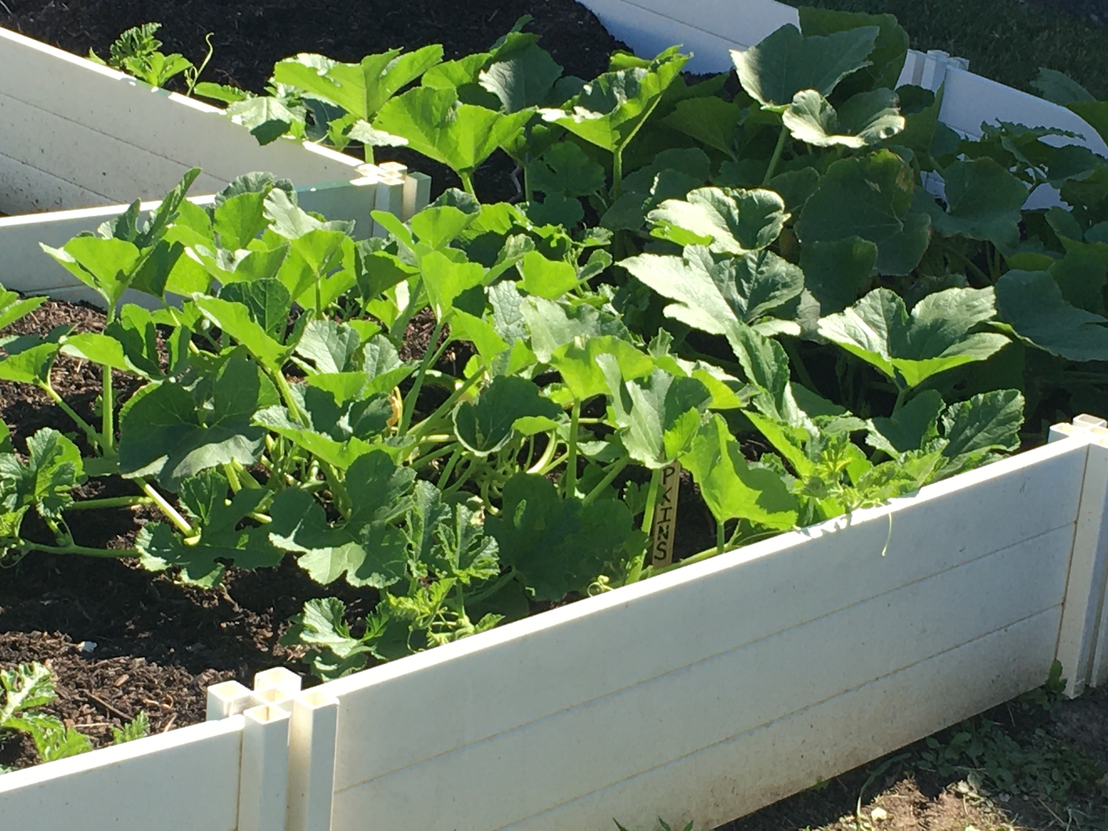
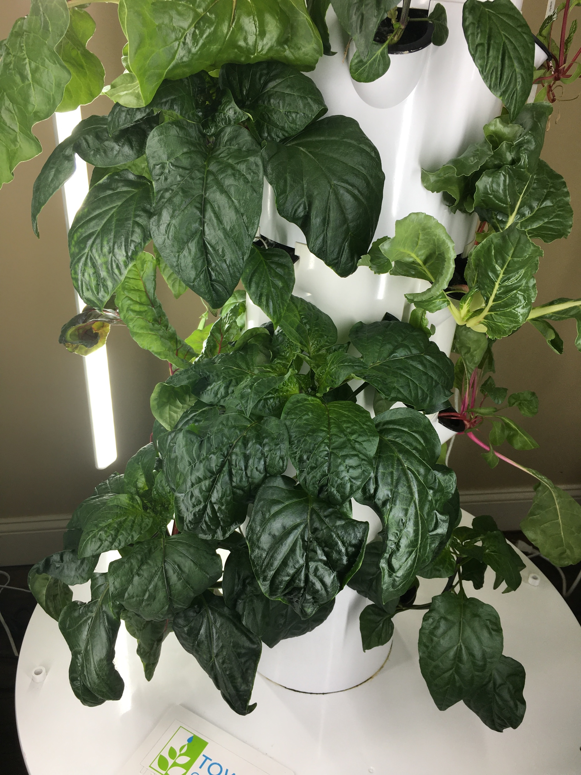
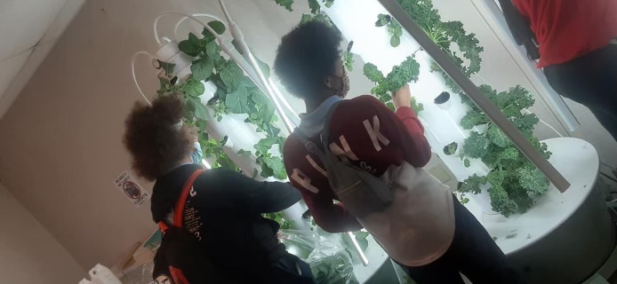

Slide 25
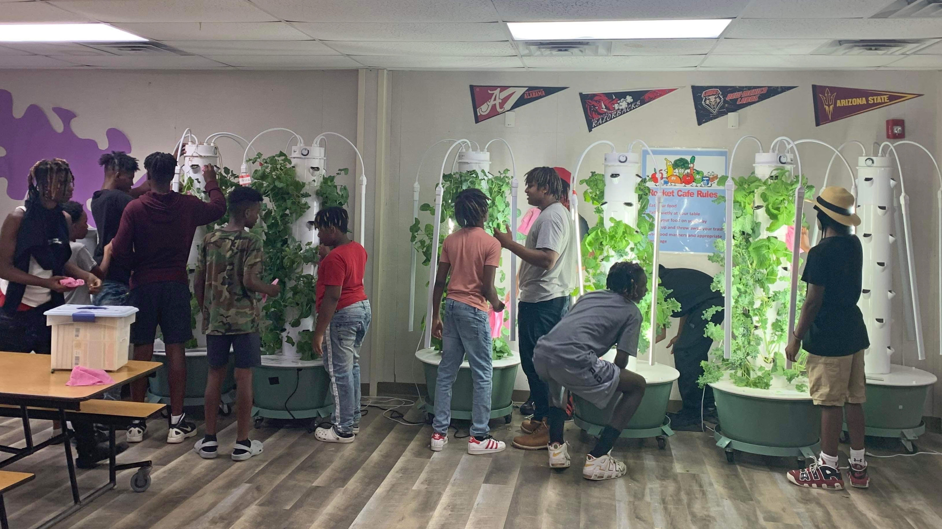

Slide 26

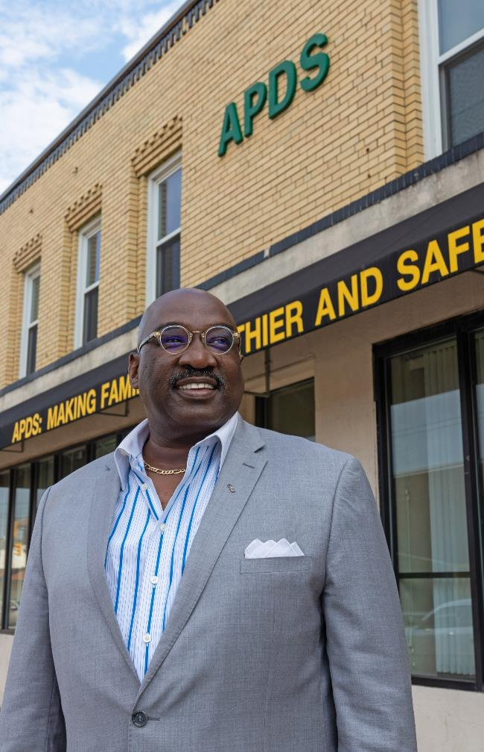
PLANNING FOR THE FUTURE
Acclimating beyond pandemic
Medication Assisted Treatment
Vivitrol
Prioritize Funding for Alcohol Use Disorder

Slide 27

The Men of Church of Christ at Genesee Avenue
“We All Rise by Uplifting Each Other”
Notes:
Right click on the mock-up, click group and click ungroup.
To change image click on the grey box twice, right click and change image

Slide 28
Mental Health Session
MAIN GROUPS OF MENTAL ILLNESSES:
Mood Disorders (such as depression or bipolar disorder)
Anxiety disorders (affects your ability to concentrate, sleep, and do ordinary tasks)
Personality disorders (Paranoid, Narcissistic, Antisocial, etc.)
Psychotic disorders (such as Schizophrenia)
Others such as eating disorders, trauma-related disorders, substance use disorders, and so on – Nearly 300 mental disorders are listed in the DSM-5 (Diagnostic and Statistical Manual of Mental Disorders)
Main groups of Mental illnesses:
1) Mood Disorders (such as depression or bipolar disorder)
2) Anxiety disorders (affects your ability to concentrate, sleep, and do ordinary tasks)
3) Personality disorders (Paranoid, Narcissistic, Antisocial, etc.)
4) Psychotic disorders ( such as schizophrenia)
Others such as eating disorders, trauma related disorders, substance use disorders-
Nearly 300 mental disorders are listed in the DSM-5 (Diagnostic and Statistical Manual of Mental Disorders)
Common Language and Asset Framing Mindset

Slide 29
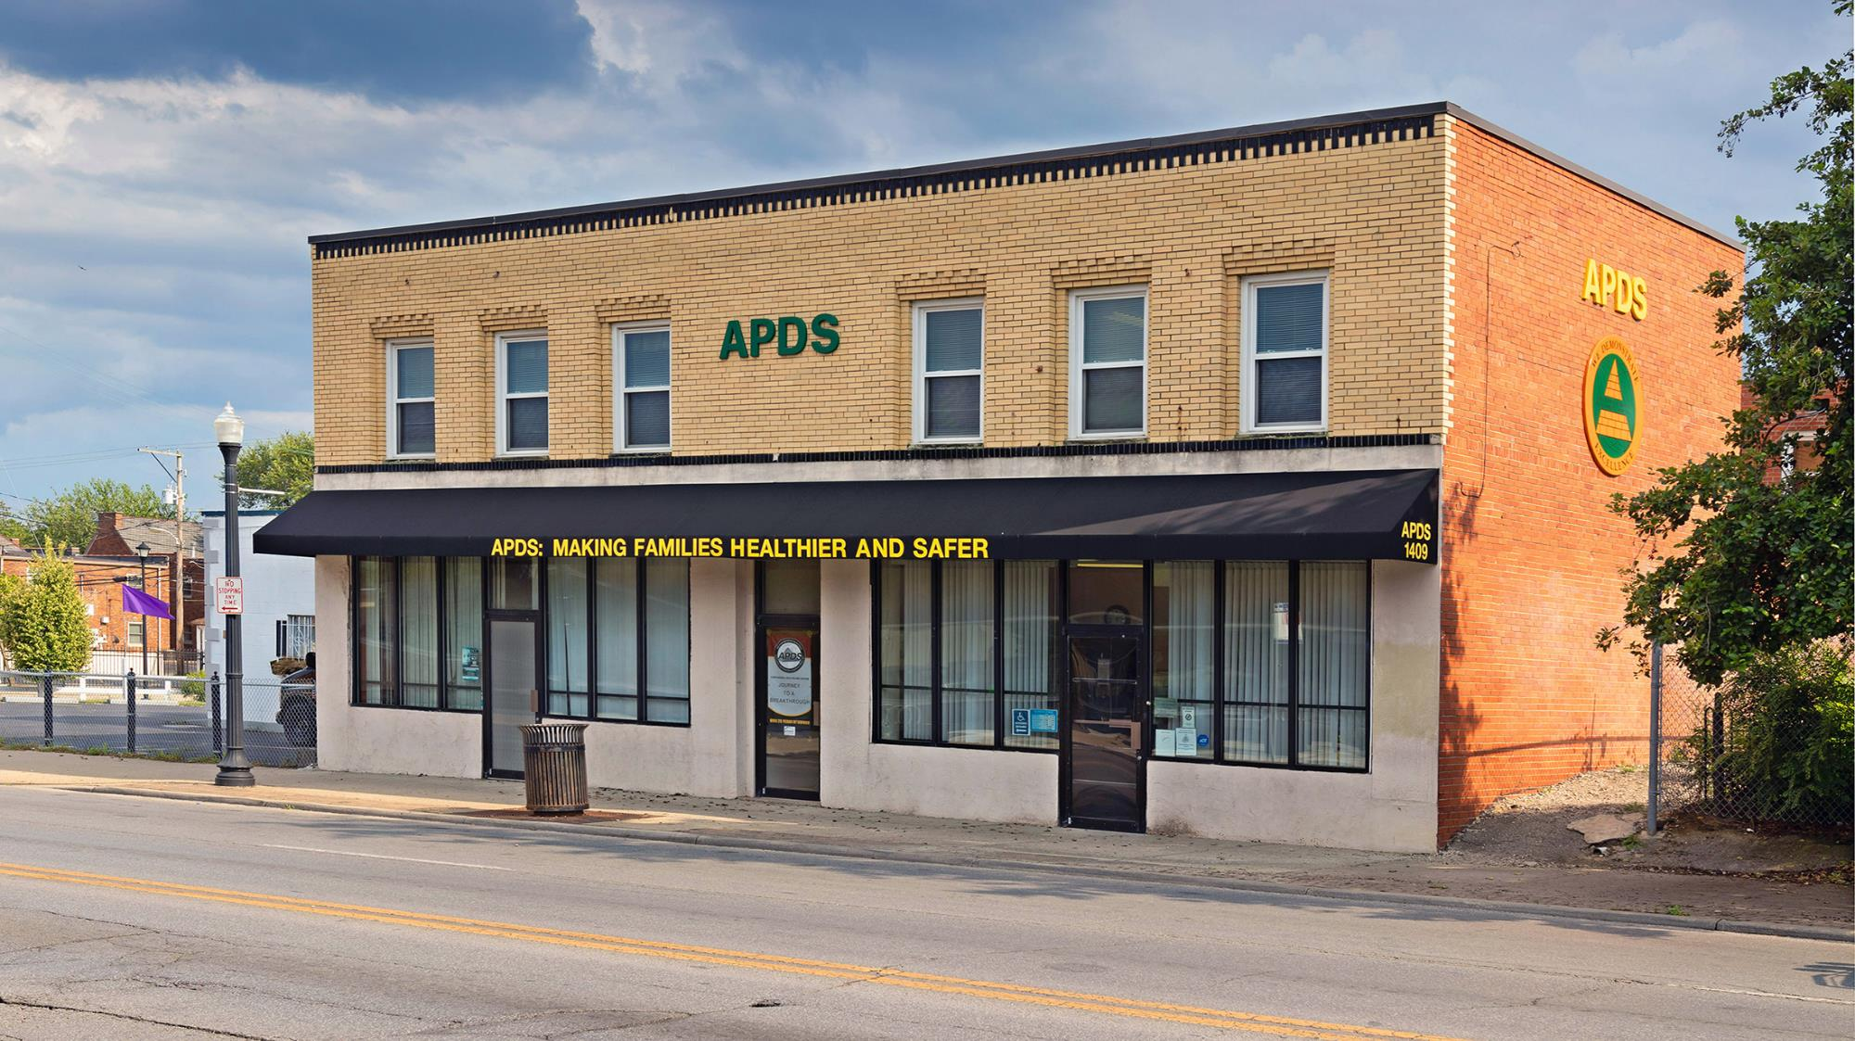
APDS: Who Are We?

Slide 30

Kujichagulia = To define, name, create,
and speak for ourselves
Globally
United States
Black Communities
Church of Christ on Genessee Avenue
30
Notes:
Right click on the mock-up, click group and click ungroup.
To change image click on the grey box twice, right click and change image

Slide 31

% OHIO Licensee Data: By Race & Professional Degree
100.0%
100.0%
92.1%
90.3%
92.6%
84.5%
83.8%
85.6%
74.7%
25.3%
15.5%
16.2%
14.4%
7.9%
9.7%
7.4%
0.0%
0.0%

Slide 32

% Ohio Licensed Social Workers: By Race & Professional Degree
Black or African American
WHITE

Slide 33

% Ohio Licensed Social Workers: By Race & Professional Degree
*** BLACK ***
Male
Female
89.5%
87.4%
85.9%
12.6%
14.1%
10.5%

Slide 34

City of Columbus Empowerment Grants
Treatment vs. Healing
34
Notes:
Right click on the mock-up, click group and click ungroup.
To change image click on the grey box twice, right click and change image

Slide 35
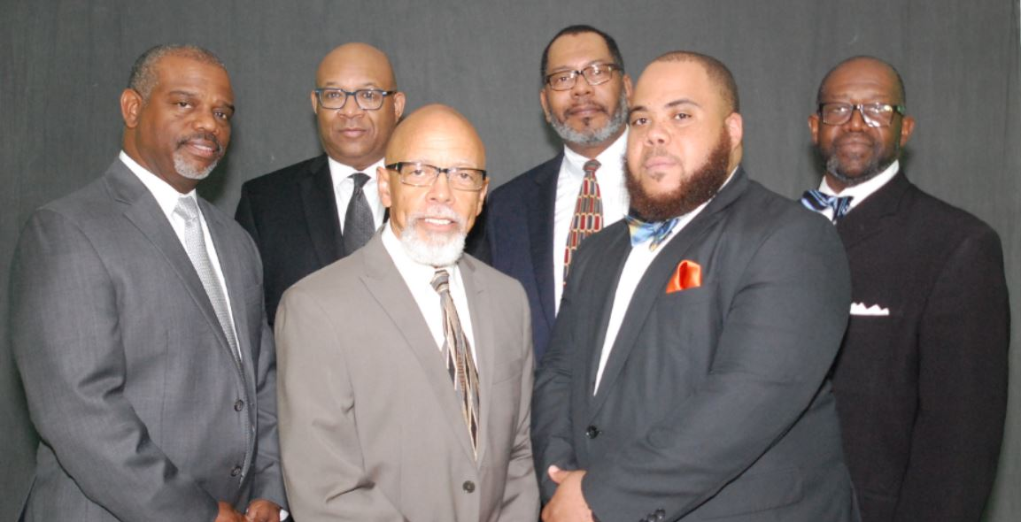
UPLIFT/Support Systems:
• Support you – list up to 5 women
• You support – list up to 5 women
35
Notes:
Right click on the mock-up, click group and click ungroup.
To change image click on the grey box twice, right click and change image

Slide 36

UPLIFT/Support Systems
• Support You – List up to 5 women
• You support – List up to 5 women
36
Notes:
Right click on the mock-up, click group and click ungroup.
To change image click on the grey box twice, right click and change image

Slide 37

UPLIFT/Support Systems
• Support You – List up to 5 men
• You support – List up to 5 men
37
Notes:
Right click on the mock-up, click group and click ungroup.
To change image click on the grey box twice, right click and change image

Slide 38
Not everything that is faced can be changed, but nothing can be changed
until it is faced.
– James Baldwin, Author
38

Slide 39
Notes:
Only this slide : you have to place image in the transparency box

Slide 40
ADDRESS:
1409 East Livingston Avenue
Columbus, Ohio 43205
PHONE:
614-253-4448
WEB:
www.apdsinc.org
THANK YOU
APDS CEO: Jerry Saunders Sr.

